Slide 1
Use of Predictive Analytics
Decreasing 30 day Hospital Readmit Rate
Innaufaze Hospital
Byte, ME.
Dale Cox, BS
Rich Friedman, M.D., MBA

Slide 2
Decreasing 30 day Hospital Readmit Rate
Congestive Heart Failure Patients
Why is this important to us?
There are currently over 6.5 million adults with CHF in the U.S. and 400-700,000 new cases/yr
In Maine alone, this accounts for 162-204 age-adjusted average annual rate per 100,000 pop. (source CDC)
The majority of these patients are age 40+ with nearly half > 60 years of age
In the ambulatory area, this amounts to between 20-30 visits per 100 persons/yr

Slide 3
Decreasing 30 day Hospital Readmit Rate
In the U.S. CHF results in 250,000 deaths/yr
It is therefore one of the most serious chronic diseases we treat in our hospital
Hospital readmissions account for 6-14% of costs in patients with this diagnosis*
Patients receiving home-based intervention identified before hospital discharge had fewer readmissions and shorter hospitalization*
*Krumholz HMParent EMTu N et al. Readmission after hospitalization for congestive heart failure among Medicare beneficiaries. Arch Intern Med. 1997;15799- 104

Slide 4
Decreasing 30 day Hospital Readmit Rate
Rationale for this Project:
Given our well established HomeCare team, identification of this group of patients prior to discharge from their initial hospitalization will result in an in-hospital consultation and a significant decrease in 30 day readmission rate with resultant significant cost savings**
This savings will help us avoid the 2% fine imposed by CMS for this diagnosis. In a similar Health Plan to ours the total cost savings (patient and Plan) was $14 Million/yr. **
**The Influence of a Postdischarge Intervention on Reducing Hospital Readmissions in a Medicare Population
Mary E. Costantino, PhD,1 Beth Frey, RN, BSN,2 Benjamin Hall, PhD, ASA, MAAA,3 and Philip Painter, MD4 . POPULATION HEALTH MANAGEMENT Volume 16, Number 5, 2013

Slide 5
Decreasing 30 day Hospital Readmit Rate
Preliminary Results:
In our pilot study using our administrative data, we looked at the co-morbidity of dementia, as this is frequent in our population > 65 years of age with CHF to improve our predictive model.
We believe the inclusion of other co-morbidites such as diabetes, cancer and myocardial infarction may further improve our selection of patients for this early intervention

Slide 6
Decreasing 30 day Hospital Readmit Rate
Preliminary Results:
Using a LACE score (L: LOS, A: Acuity, C: Co-morbidity, E: # of ER Admissions) we looked at patients with the aforementioned diagnoses: CHF + Dementia
We were able to successfully predict readmission based on these two pre-discharge factors with an accuracy of 82% and with a 95% CI of 81%-83%.
The negative predictive value is exceedingly high giving us reassurance that the model will result in a valid model (see chart)

Slide 7
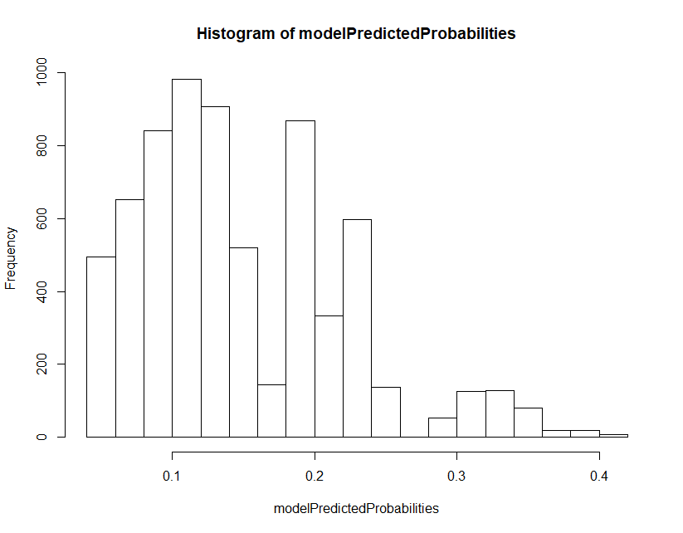
Decreasing 30 day Hospital Readmit Rate
Preliminary Results:
We set the threshold to 0.25. This value was chosen as you can see it incorporates most of the values.
Fig. 1

Slide 8
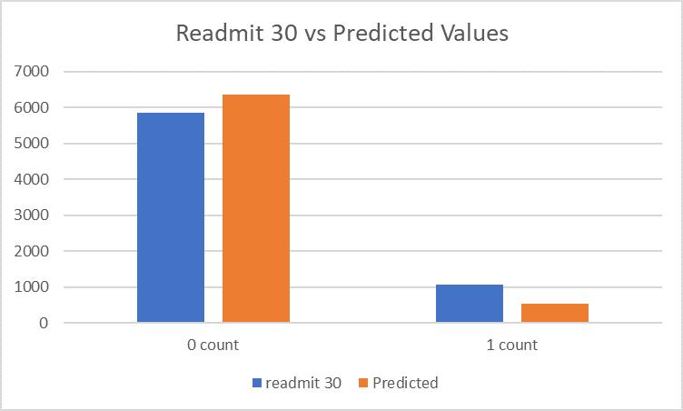
Decreasing 30 day Hospital Readmit Rate
Preliminary Results:
Fig 2
Fig 2 is a graph of the results using the LACE index and the actual prediction using the model. Note the accuracy of the the “Score” versus the “Predict” .

Slide 9
Decreasing 30 day Hospital Readmit Rate
Limitations
The current model uses only 2 variables: CHF and Dementia.
Some patients may have been readmitted to other hospitals that were not identified in our administrative database. This would also include those who have died outside the region.
Our current data set has limited historical information. As our patient numbers increase, this will improve the model.

Slide 10
Decreasing 30 day Hospital Readmit Rate
Summary
We believe that using our administrative data which is very accessible we can:
Accurately predict 30 day hospital readmission patients with CHF using a LACE score that incorporates many of the most common co-morbidities associated with these patients.
Realize a significant cost savings and ROI for the Hospital and Health Plan. This is likely to be enhanced using additional co-morbidities.
Better utilize our Home Health Care team in accomplishing these goals.

